Slide 1
Responsible Data Collection

Slide 2
Potential Bias in Speech Recognition
Gender
Sources of Bias
Notes:
Critical challenge for data engineering
Will discuss fairness and bias in an upcoming module
There are always biases in the data and where it comes from
Common Voice tries to address key issues in speech recognition
Users may speak multiple languages
How can you collect data for each :
age group
accent
dialect
gender
etc?

Slide 3
Potential Bias in Speech Recognition
Gender
Gender
Sources of Bias
Notes:
Critical challenge for data engineering
Will discuss fairness and bias in an upcoming module
There are always biases in the data and where it comes from
Common Voice tries to address key issues in speech recognition
Users may speak multiple languages
How can you collect data for each :
age group
accent
dialect
gender
etc?

Slide 4
Potential Bias in Speech Recognition
Gender
Age
Group
Gender
Sources of Bias
Notes:
Critical challenge for data engineering
Will discuss fairness and bias in an upcoming module
There are always biases in the data and where it comes from
Common Voice tries to address key issues in speech recognition
Users may speak multiple languages
How can you collect data for each :
age group
accent
dialect
gender
etc?

Slide 5
Potential Bias in Speech Recognition
Gender
Age
Group
Accent
Gender
Sources of Bias
Notes:
Critical challenge for data engineering
Will discuss fairness and bias in an upcoming module
There are always biases in the data and where it comes from
Common Voice tries to address key issues in speech recognition
Users may speak multiple languages
How can you collect data for each :
age group
accent
dialect
gender
etc?

Slide 6
Potential Bias in Speech Recognition
Gender
Age
Group
Accent
Dialect
Gender
Sources of Bias
Notes:
Critical challenge for data engineering
Will discuss fairness and bias in an upcoming module
There are always biases in the data and where it comes from
Common Voice tries to address key issues in speech recognition
Users may speak multiple languages
How can you collect data for each :
age group
accent
dialect
gender
etc?

Slide 7
Potential Bias in Speech Recognition
Gender
Age
Group
Accent
Dialect
Language
Gender
Sources of Bias
Notes:
Critical challenge for data engineering
Will discuss fairness and bias in an upcoming module
There are always biases in the data and where it comes from
Common Voice tries to address key issues in speech recognition
Users may speak multiple languages
How can you collect data for each :
age group
accent
dialect
gender
etc?

Slide 8
Bias and Market Forces
Gender
Age
Group
Accent
Dialect
Language
Sources of Bias
Your ML research problem
Debiasing
Requirements
ML Dataset
Notes:
You can’t always collect the data yourself - you might be limited by scale
Data processing is a big and active market, there are many labeling companies that will build datasets for you.
There’s also services like Mechanical Turk - gig economy
You can understand all the potential sources of bias, and set requirements to avoid them
but how do you communicate and enforce those requirements to the intermediaries which go out and collect the data for you?
Dataset-building: active commercial space
Companies/startups
Directly pay gig workers
@vj@eecs.harvard.edu the first one was smaller on purpose because you can't get as big of a dataset sometimes without help -- trying to motivate why you would use an intermediary
https://thenounproject.com/search/?q=uncertainty&i=3188924
https://thenounproject.com/search/?q=quantity&i=3433022

Slide 9


Bias and Market Forces
Gender
Age
Group
Accent
Dialect
Language
Sources of Bias
Larger!
ML Dataset
Your ML research problem
Debiasing
Requirements
Intermediary
Notes:
You can’t always collect the data yourself - you might be limited by scale
Data processing is a big and active market, there are many labeling companies that will build datasets for you.
There’s also services like Mechanical Turk - gig economy
You can understand all the potential sources of bias, and set requirements to avoid them
but how do you communicate and enforce those requirements to the intermediaries which go out and collect the data for you?
Dataset-building: active commercial space
Companies/startups
Directly pay gig workers
https://thenounproject.com/search/?q=uncertainty&i=3188924
https://thenounproject.com/search/?q=quantity&i=3433022

Slide 10

Data Engineering and Bias
Amazon Mechanical Turk is a crowdsourcing platform used for labeling data for ML tasks
Notes:
Amazon Mechanical Turk is a crowdsourcing website for businesses to hire remotely located "crowdworkers" to perform discrete on-demand tasks that computers are currently unable to do.
https://fr.wikipedia.org/wiki/Fichier:Amazon_mechanical_turk_beta_logo.jpg FAIR USE

Slide 11
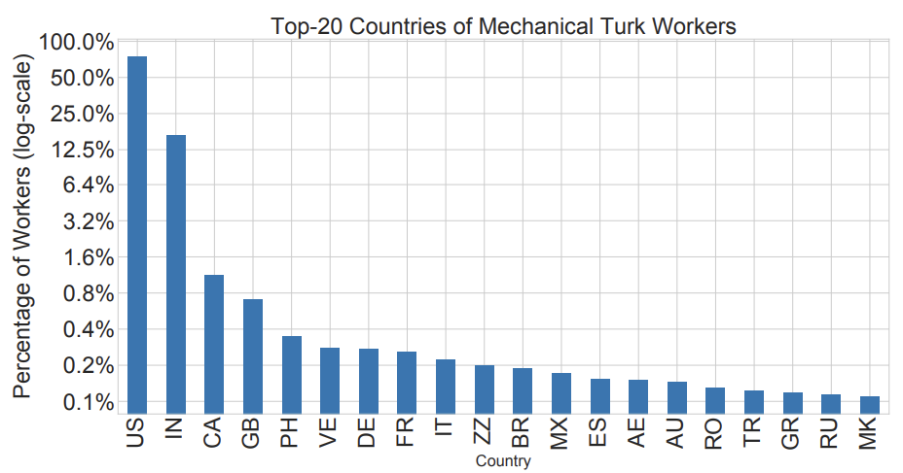
Data Engineering and Bias
Amazon Mechanical Turk is a crowdsourcing platform used for labeling data for ML tasks
Workers are (not) unbiased

Slide 12
Bias and Market Forces
ML Dataset
Gender
Age
Group
Accent
Dialect
Language
Sources of Bias
Intermediary
Your ML research problem
Debiasing
Requirements
Intermediaries: help with collection but a potential source of bias
Notes:
You can’t always collect the data yourself - you might be limited by scale
Data processing is a big and active market, there are many labeling companies that will build datasets for you.
There’s also services like Mechanical Turk - gig economy
You can understand all the potential sources of bias, and set requirements to avoid them
but how do you communicate and enforce those requirements to the intermediaries which go out and collect the data for you?
Dataset-building: active commercial space
Companies/startups
Directly pay gig workers
https://thenounproject.com/search/?q=uncertainty&i=3188924
https://thenounproject.com/search/?q=quantity&i=3433022

Slide 13
How can you work to
avoid bias in your dataset?
Notes:
Speech Commands established a new standard dataset for the first time for KWS research
Data engineering for TinyML requires additional careful thought
How accurate is your algorithm? How much can you sacrifice accuracy to make the model fit on your tinyml device?
How will you compare to other solutions? You need benchmarks
How efficient is your hardware?
How will you compare it to other platforms? You need benchmarks!

